Slide 1
Apollyon’s Curse
Milestone 1 Progress

Slide 3
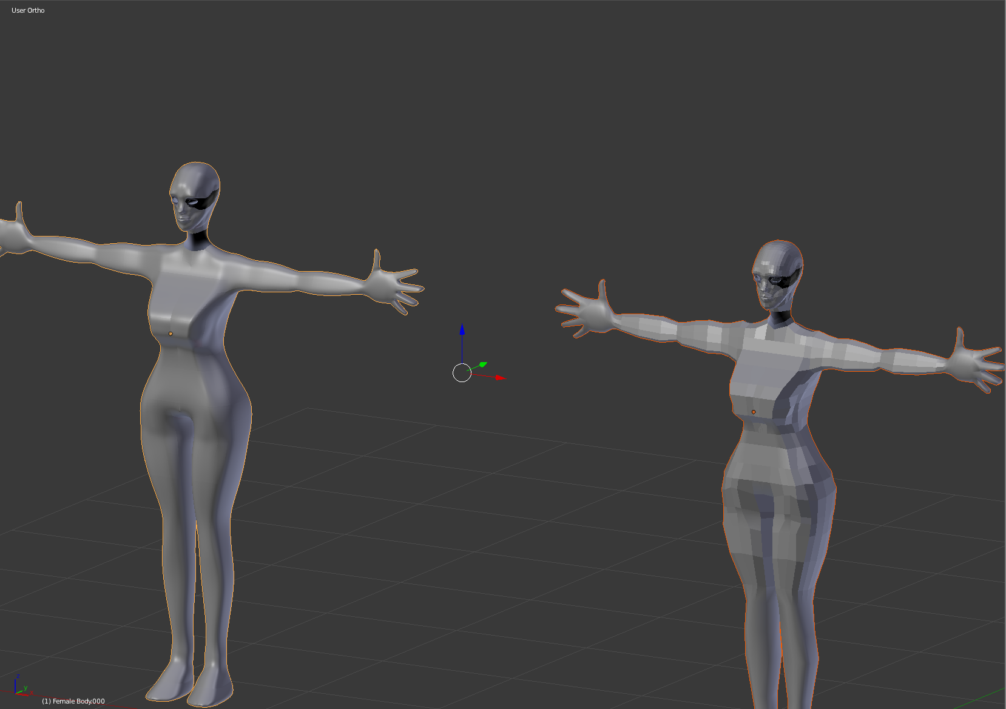
Main Character…so far
For now the our main character mesh is complete the next steps for me are getting the mesh ready for UV mapping and texturing.
This will be after I finish creating and rigging our enemies and assets for the environment.

Slide 4
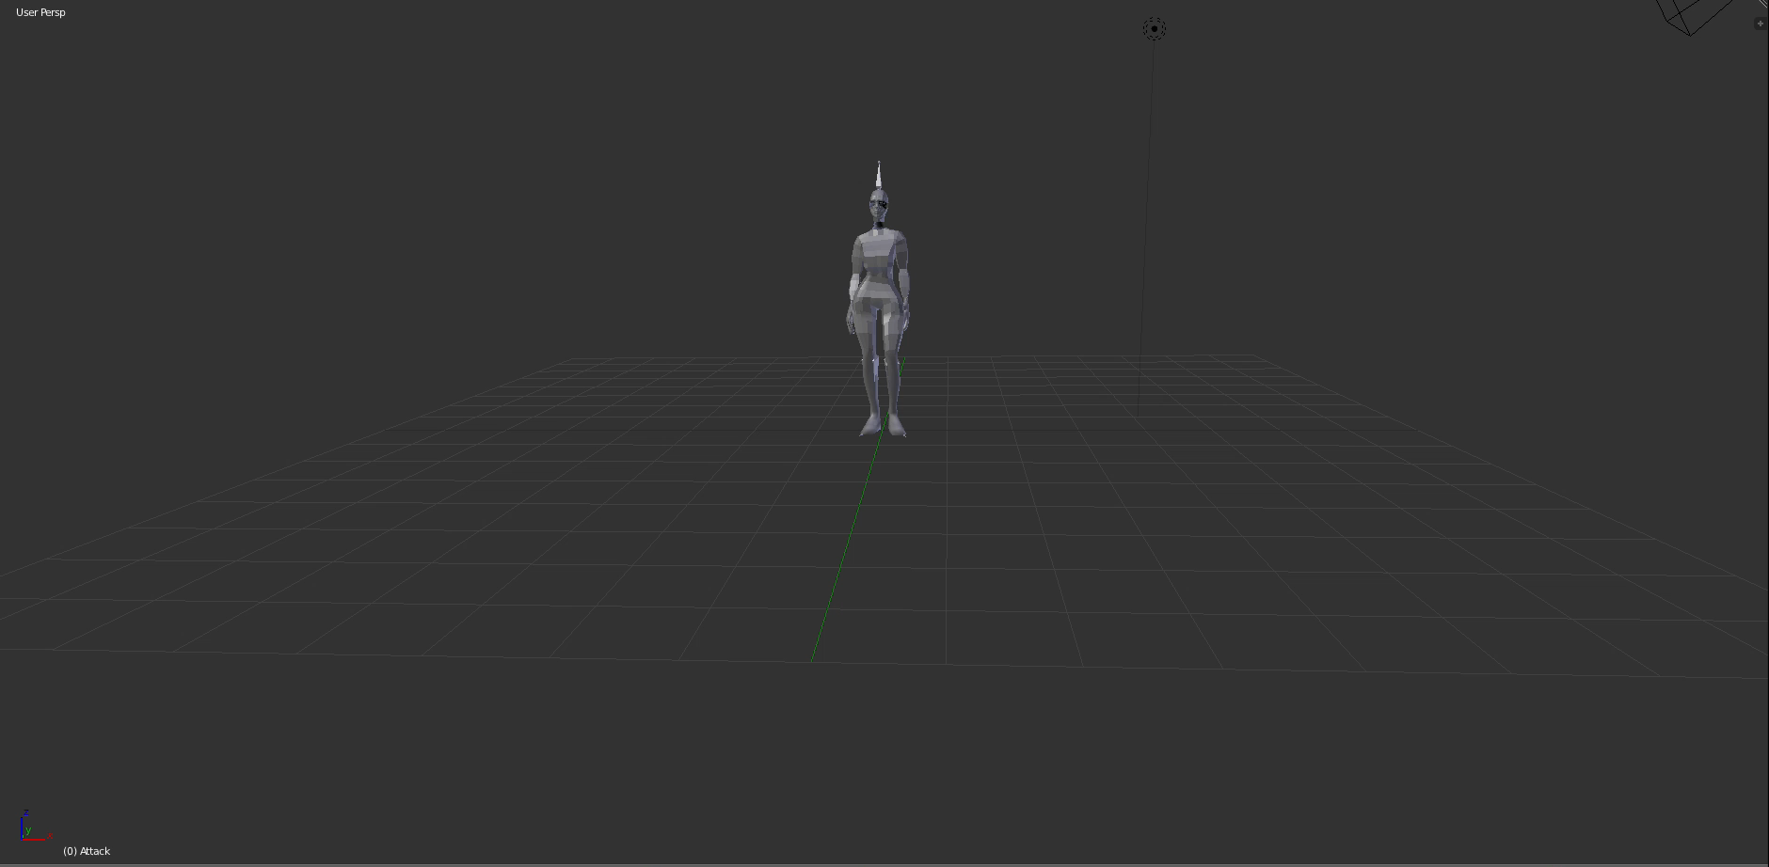
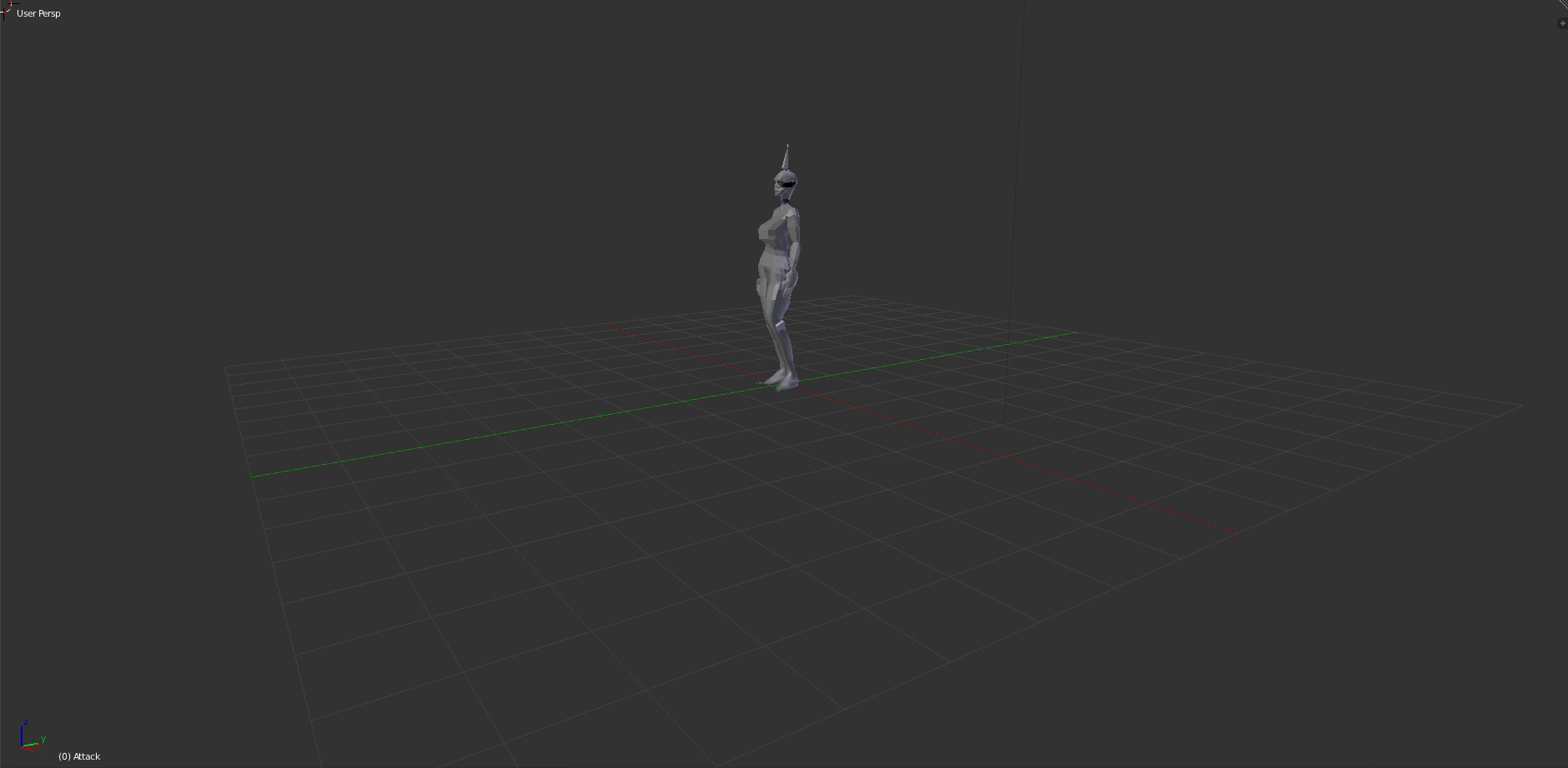
Animations
Auto-rigging and animations provided by Mixamo
https://www.mixamo.com/#/

Slide 5
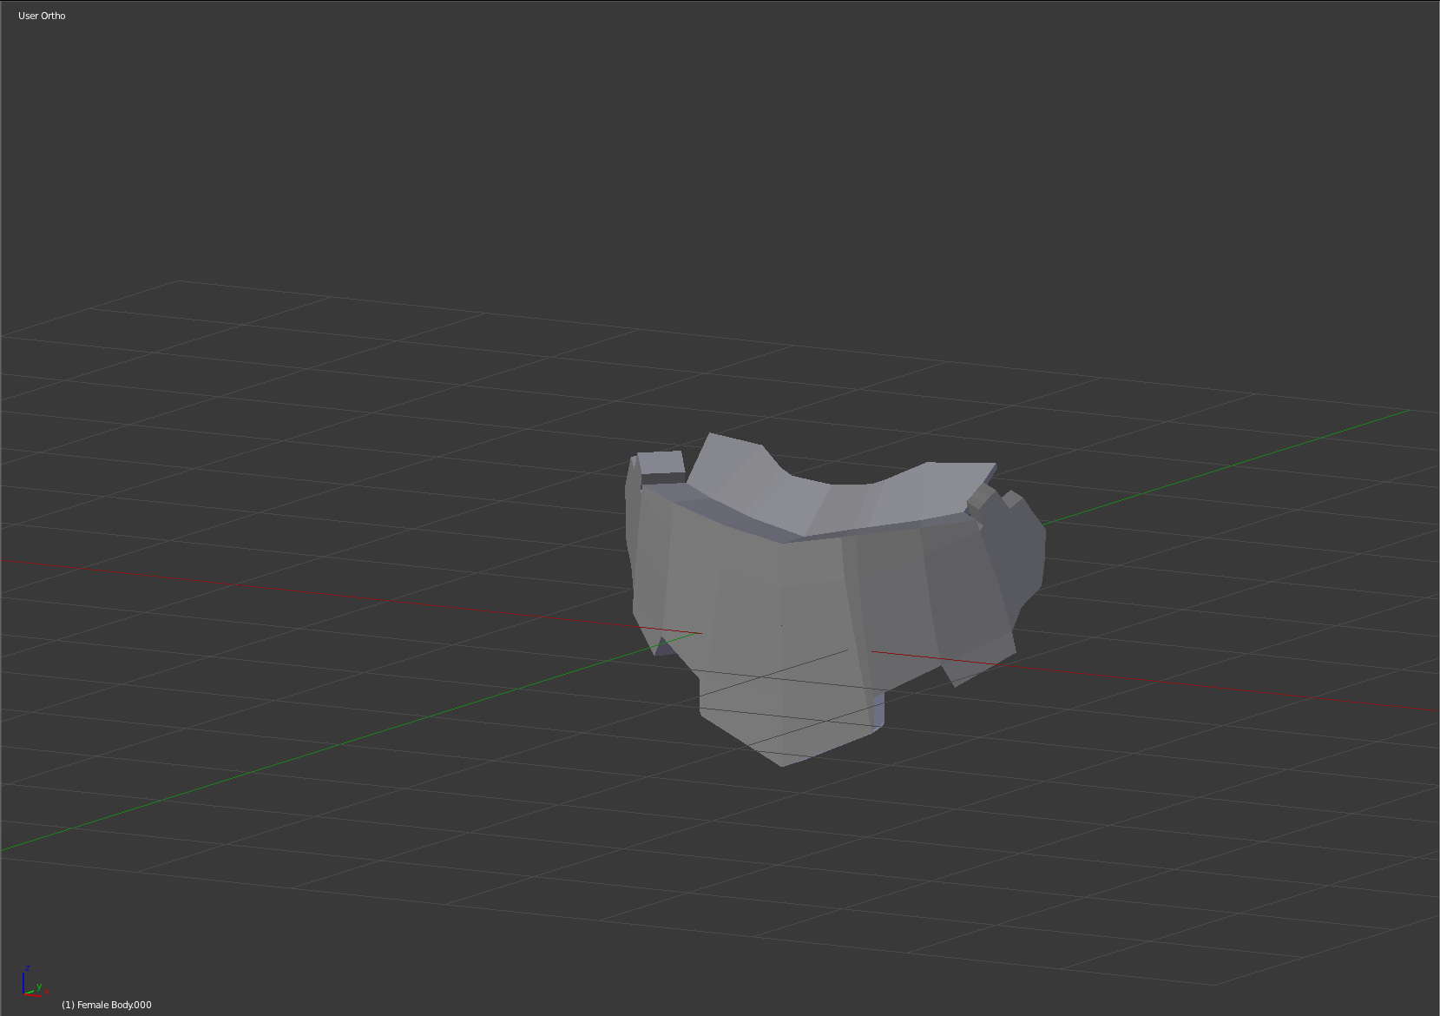
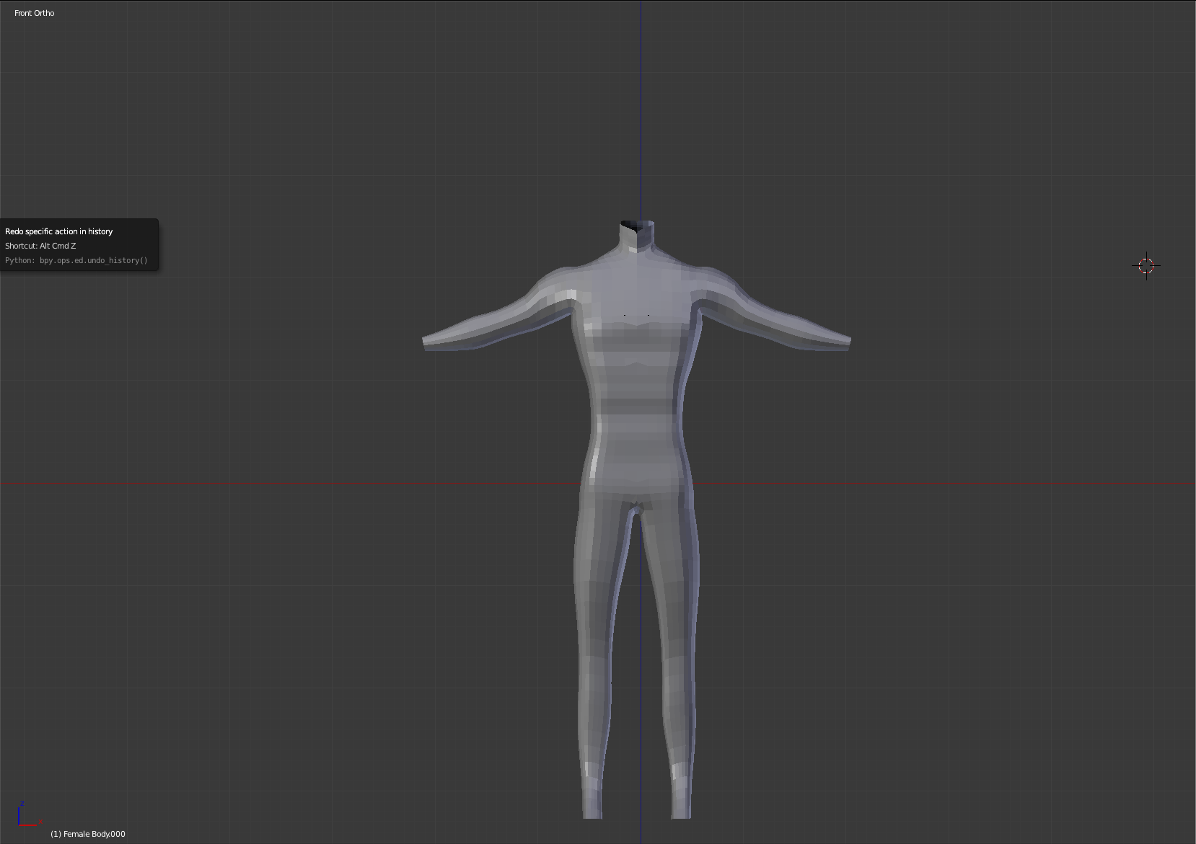
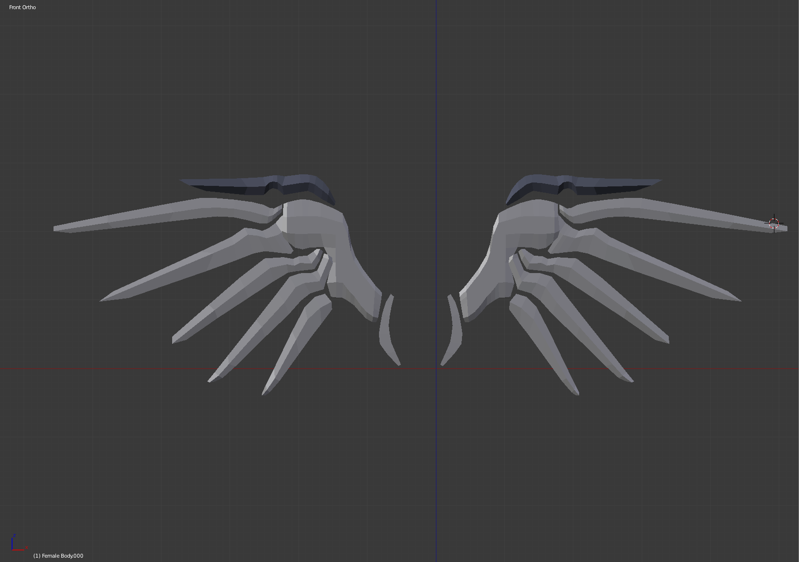
In Progress

